Slide 1


Slide 2

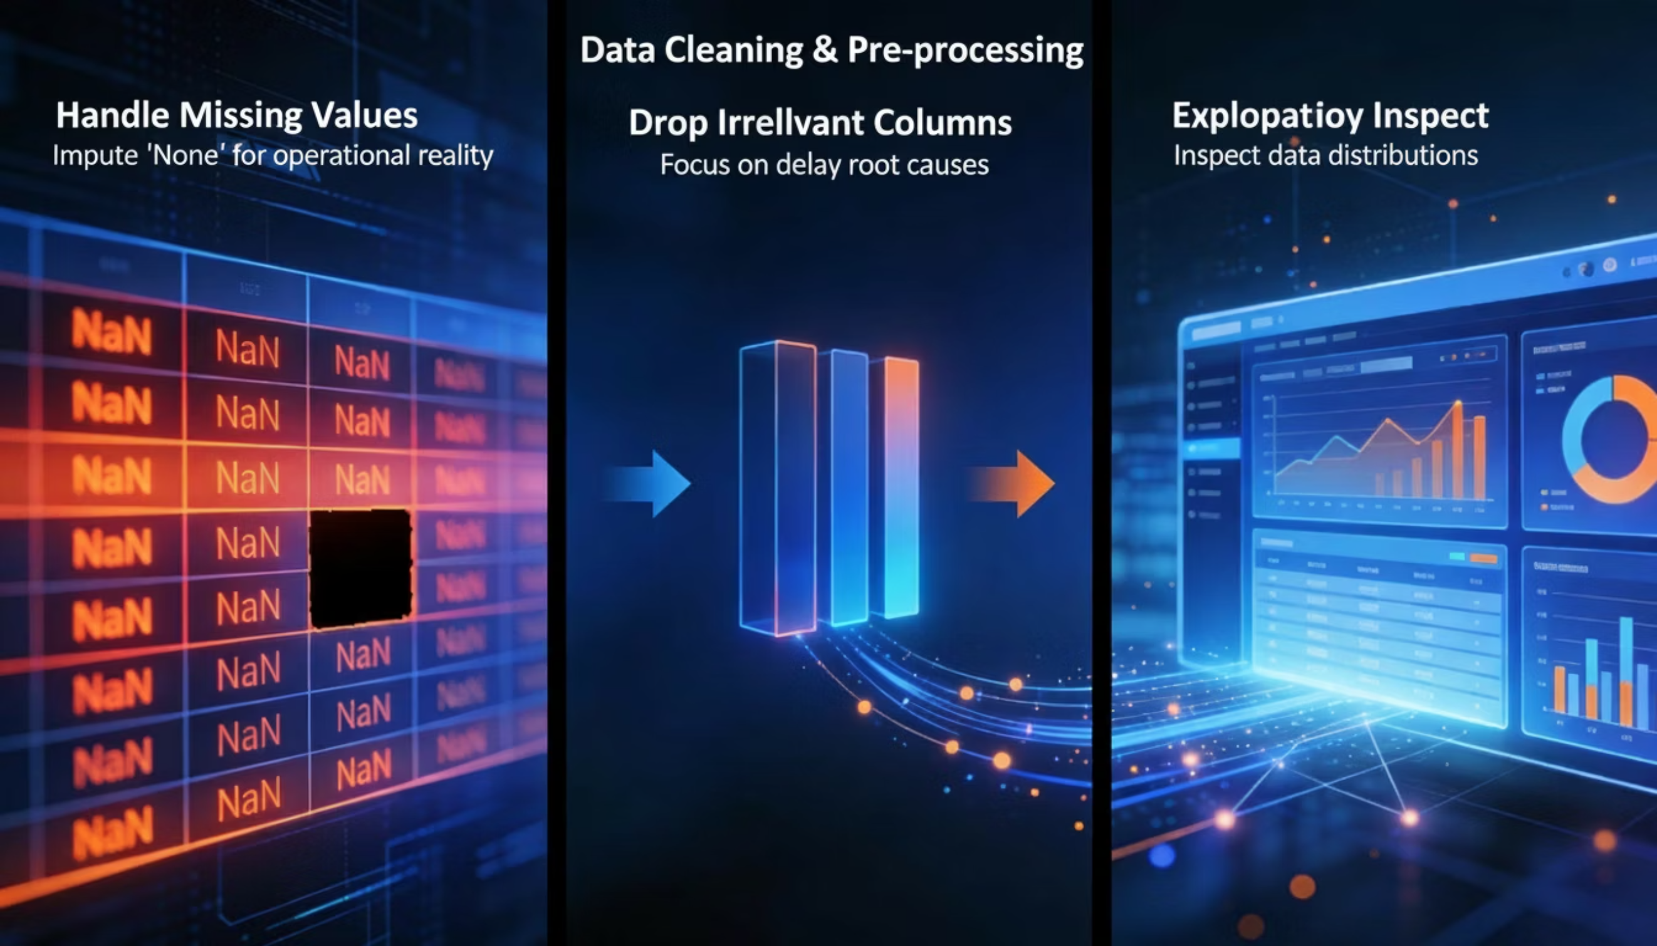
Data Cleaning & Pre-processing
To ensure the accuracy and reliability of our analysis, we will prepare the dataset by addressing missing values, removing irrelevant features, and conducting an initial inspection of the data distributions. This structured approach allows us to refine our dataset, making it suitable for robust analytical modeling.

Slide 3

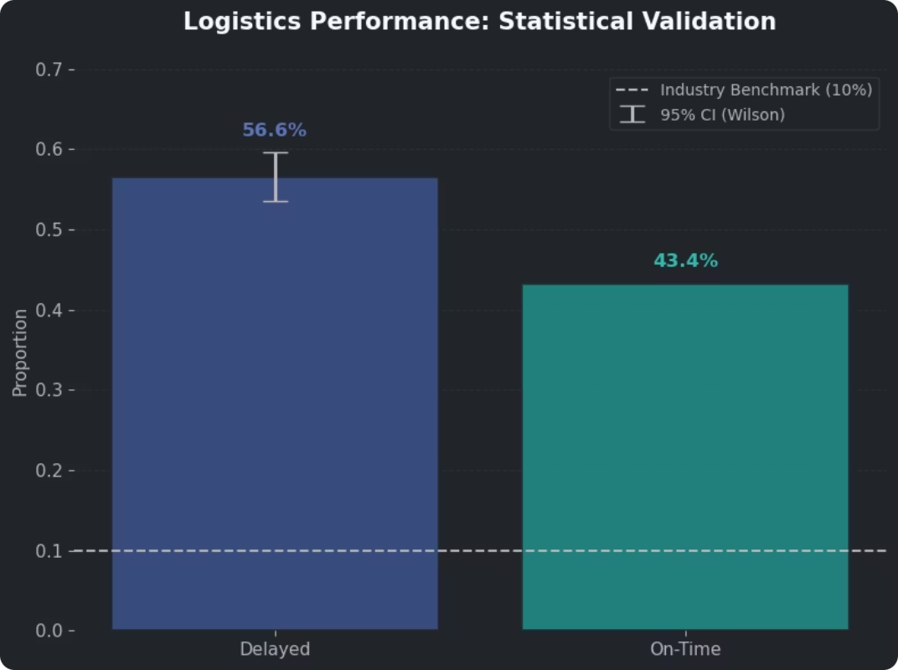
CRITICAL FINDING
56.6% Delivery Failure Rate
Statistical Validation
Business Impact
Wilson 95% confidence interval confirms delay rate between 53.5-59.6%, more than 5x above the 10% industry benchmark.
23% of customers won't buy again after delayed delivery
21% lose trust in the brand
$250-500 penalty per late delivery to major retailers
15% margin erosion from expedited shipping costs

Slide 4

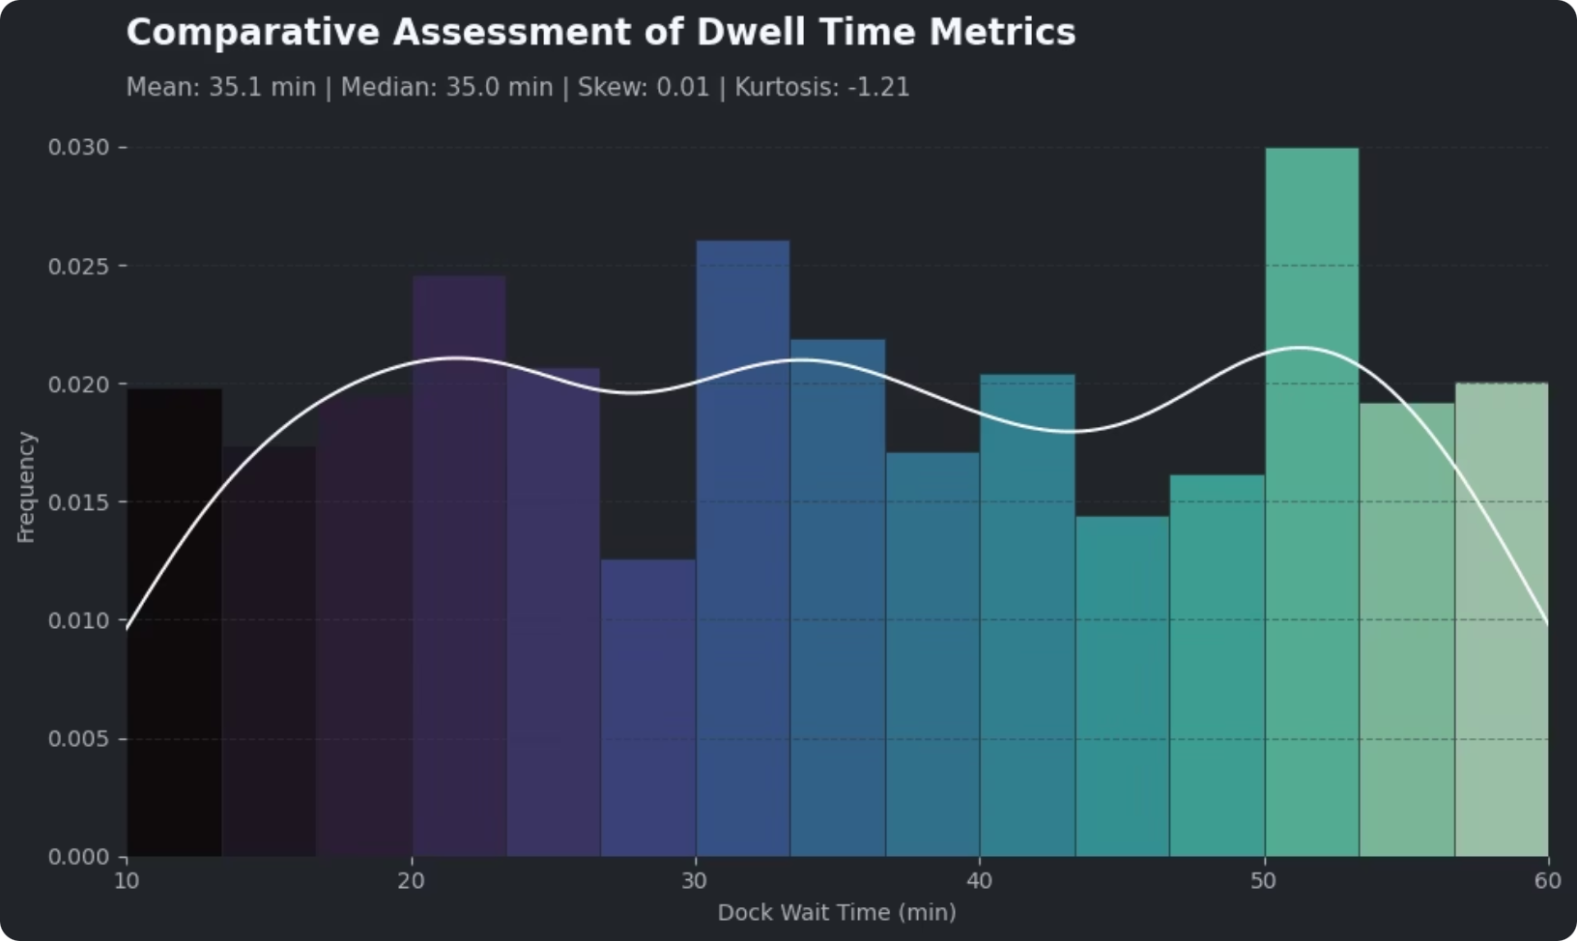
Root Cause Analysis
Dock Performance: Strong
Average wait time of 35 minutes—well below the 84-minute industry benchmark. Warehouse operations are not the bottleneck.

Slide 5

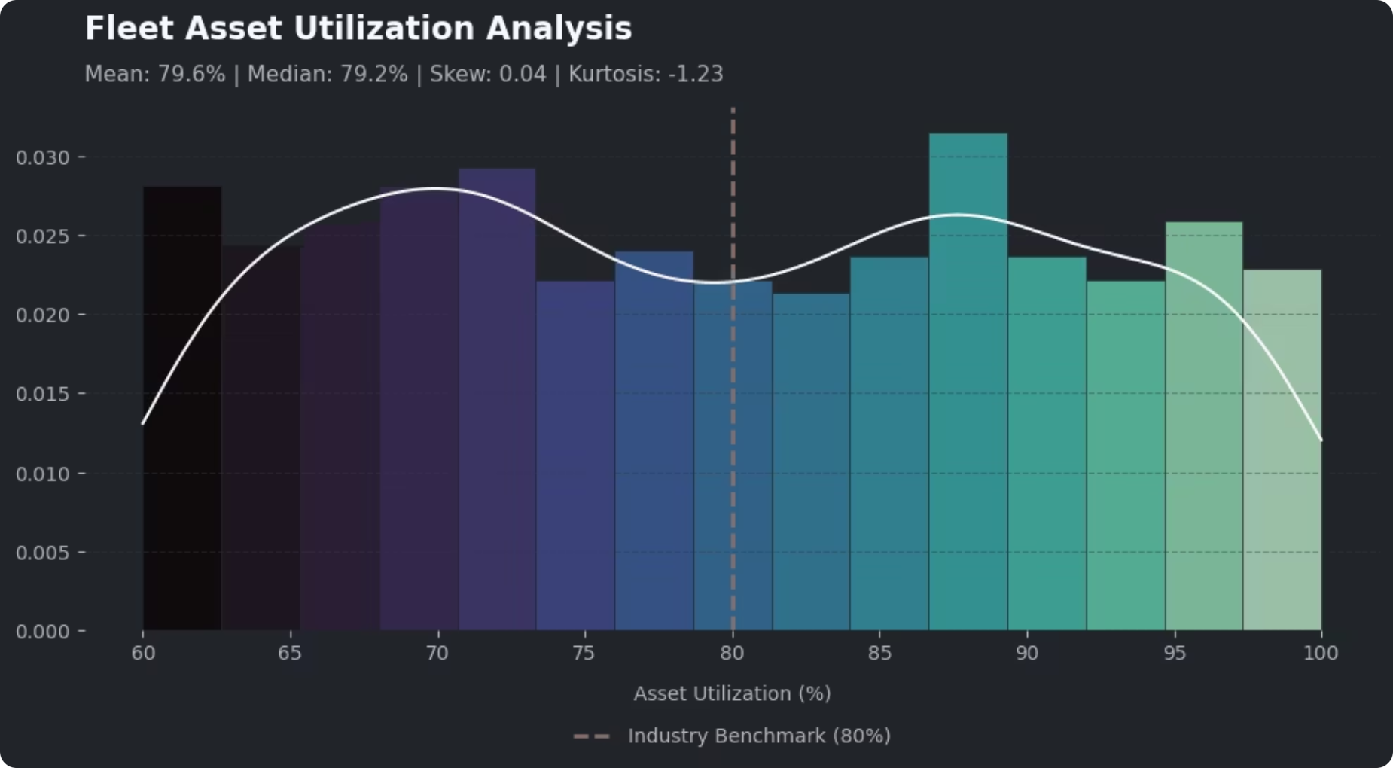
Utilization: Critical Threshold
Fleet operates at 79.6% average utilization, at or beyond the 70-80% optimal range. No buffer capacity remains.

Slide 6

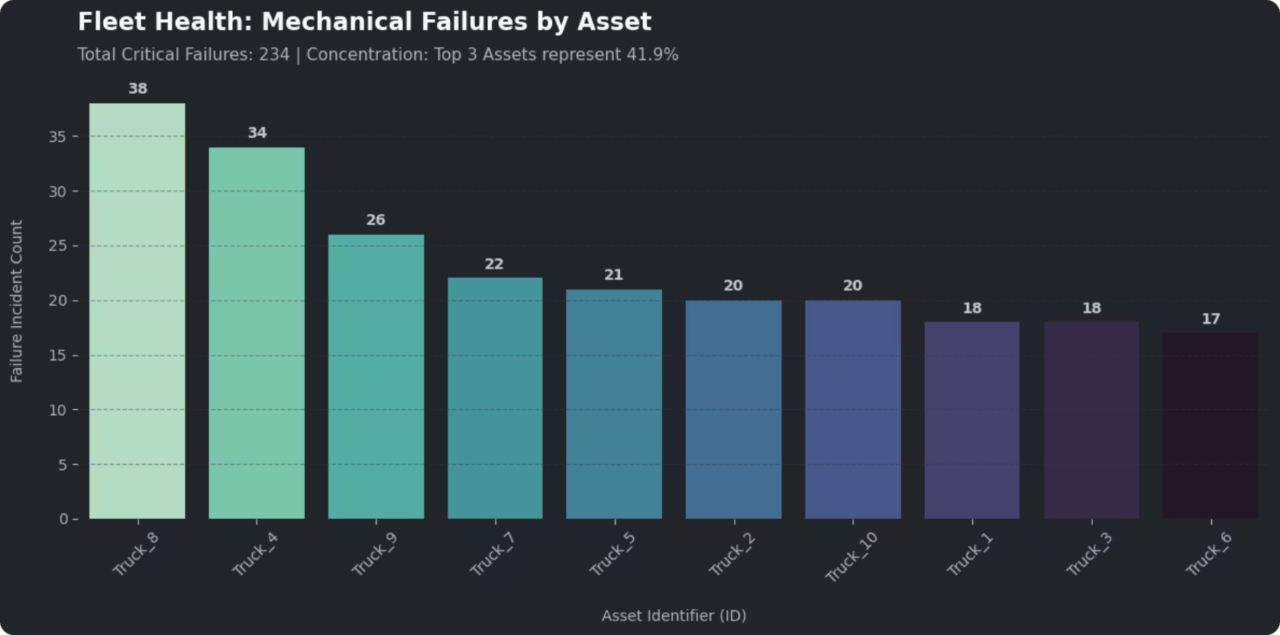
Mechanical Reliability Crisis
234
17-38
21.9%
Total Fleet Failures
Failures Per Truck
Industry Defect Rate
Across the entire year—averaging 0.64 failures per day, or one breakdown every 37 hours.
Even the best-performing asset fails more than once per month. Top 3 trucks account for 42% of all breakdowns.
TÜV benchmark for heavy-duty trucks. Our fleet substantially exceeds this threshold across all assets.

Slide 7
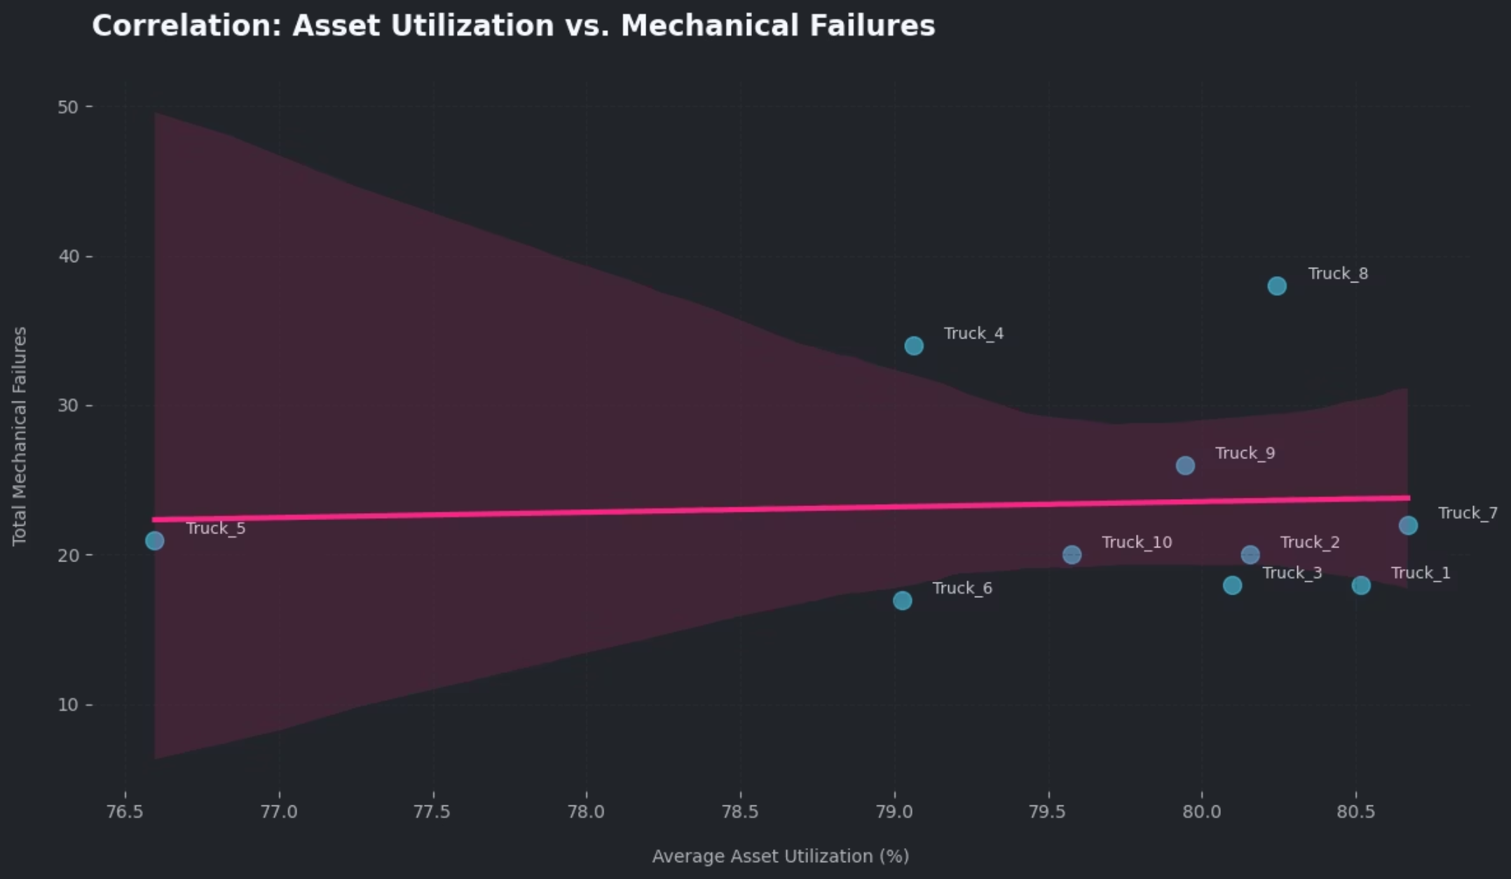
Asset Utilization vs. Mechanical Failures
Key Finding
Trucks clustered between 79-81% utilization show radically different failure counts (17 to 38). Once the fleet enters high-utilization saturation, degradation becomes asset-specific rather than volume-driven.
Maintenance history and intrinsic mechanical condition become dominant failure predictors.

Slide 8

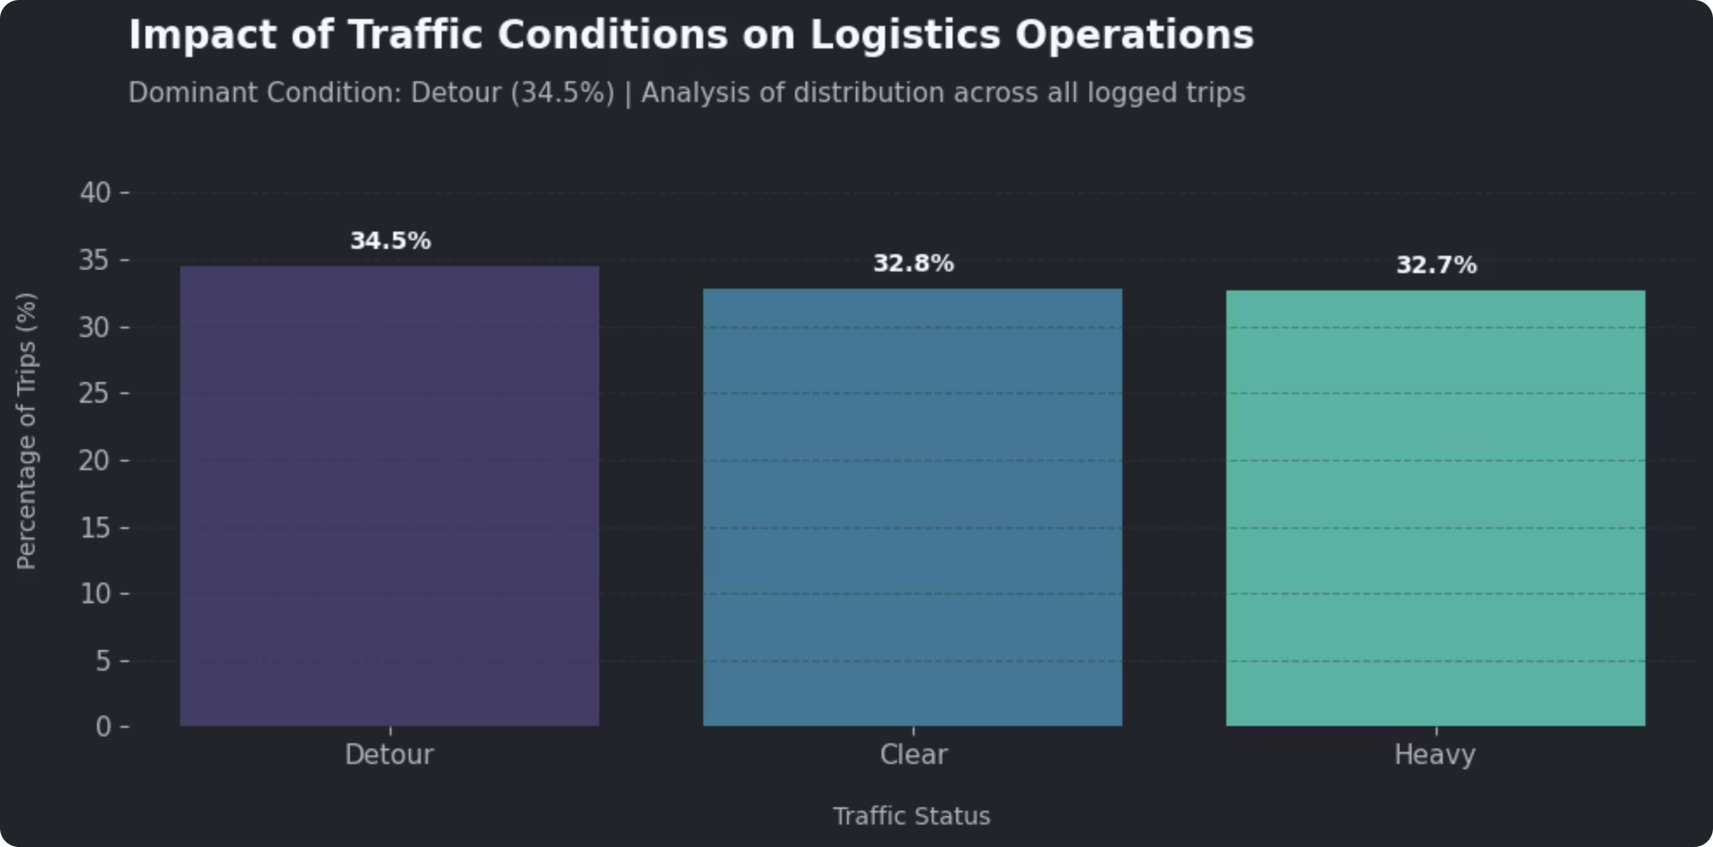
Traffic Conditions Show No Dominant Pattern
The distribution of traffic conditions across all monitored trips reveals a near‑uniform split: Detour (34.5%), Clear (32.8%), and Heavy (32.7%). This indicates that no single traffic status dominates the operational landscape, and therefore, traffic alone cannot be immediately identified as the primary driver of delays.

Slide 9

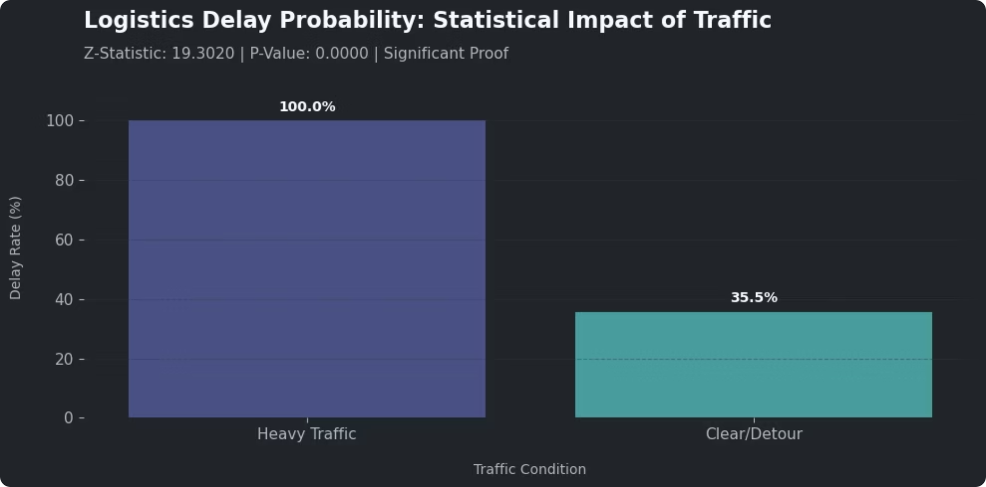
Traffic Impact: A Deterministic Failure Mode
Statistical Proof
Two-sample Z-test yields Z-statistic of 19.3020 with p-value of 0.0000, confirming heavy traffic is not just correlated with delays
IT guarantees them
Heavy-traffic corridors must be treated as "no-go zones" for time-sensitive deliveries.

Slide 10
Performance Benchmarking
1
Dock Wait Time
2
Asset Utilization
Competitive Position
35.1 min vs. 84 min benchmark
79.6% vs. 70-80% optimal
The fleet demonstrates strong dock management but operates at structural capacity limits with widespread mechanical fragility.
Superior performance
Critical threshold
Waiting times are competitive, but the main bottlenecks are on the road and inside the vehicles—not at the warehouse door.
3
Mechanical Failures
17-38/year vs. 21.9% defect rate
Systemic risk

Slide 11
Strategic Priorities for Recovery
01
02
Redesign Network Routes
Create Capacity Buffers
Map and avoid heavy-traffic corridors with 100% delay probability. Implement time-window optimization and service segmentation for critical loads.
Lower structural utilization to 70-75% range by adding flexible capacity, rebalancing routes, and smoothing demand through delivery-slot configuration.
03
04
Tiered Maintenance Strategy
Data-Driven Governance
Immediate diagnostic of top-failure trucks, implement predictive maintenance program, and execute medium-term asset renewal plan for chronic outliers.
Track core KPIs with explicit thresholds that trigger route redesign, capacity adjustments, or maintenance actions in recurring operational reviews.

Slide 12


